Slide 1
System Design Overview
Group 5: Tabulation/Collection
Miguel Gapud, Abram Miller,
Marissa Morton, Michael Zuppardo

Slide 2
Table of Contents
RAD Overview
Success Criteria Requirements
FURPS
Present Requirement and Analysis Diagrams
Class and Object diagrams
Use Case Model and UI
Sequence Diagram
Tracked Changes
Diagram Changes
System Design Diagrams
Component Diagram
Tabulation System Diagram
System Sequence Diagram
Trace requirements through Design
Questions

Slide 3
RAD Overview
The purpose is to count votes and handle vote weighting.
We are creating a system that is secure, accurate, and that presents results in a structured way to only the proper people.
There is no centralized system for voting on campus, so we are creating one to be used in the student body and club elections.
When not done by pen and paper, most voting is done by Google Forms and Qualtrics.

Slide 4
Success Criteria Requirements
We are going to make an application that will receive votes, verify that we have as many ballots as voters interacting with the system, and display the vote count to the screen.
The system will be able to handle a number of votes equal to double the number of the student population to account for the case of a popular election of many candidates at once.
The system will also have a simple UI designed so the end user can operate the program without the need to undergo extensive training on system operation.

Slide 5
FURPS- Functionality
Functionality: The behavior of the system, including the features it has and the functions it can execute.
What kind of information is tabulated by the system?
What kind of information does the system allow the user to view?
What can the vote arbiter do with the tabulated data?
Notes:
The system will calculate who the winner is, the standings of the other candidates, and how many votes each candidate received. We plan to support FPTP (first-past-the-post) and RBV (ranked-based-voting) formats, so we need to be able to handle both simple vote counting and weighted vote counting.
Only the vote arbiter will see results so the student government has full control over the distribution of the results.
To protect privacy, the vote arbiter will have no power over voter information. They see the total votes for each candidate, and for what position those candidates were running.

Slide 6
FURPS- Usability
Usability: The ease with which a user can learn to operate, prepare inputs for, and interpret outputs of a system or component.
How does the user request election results?
How does the user read election results?
What systems are in place to ensure no prior training is required?
Notes:
The user requests election results through the application itself. They press a button which shows the results to the ongoing election. Once we have verified that election period is over and that the results are accurate, we display them on screen.
Depending on the type of election (FTFP, RBV, etc.), we will organize the tabulated vote counts for the user to read. Most likely, there will not be enough options for the readability of the data to be a problem in a simple bar graph.
To ensure no prior training is required to use the system, we clearly label each button or functionality of the system so that it is understandable and seamless to use. The design of the UI and other elements is as simplistic as possible to ensure there is no confusion.

Slide 7
FURPS- Reliability
Reliability: The ability of a system or component to perform its required functions under stated conditions for a specified period of time.
What issues are generated from a system crash?
How does the system ensure data is not corrupted upon a crash?
How does the system recover after a crash?
Notes:
If the system were to crash, it should not become too much of an issue. Since we do not expect the actual tabulation of votes to take very long, even if the program were to crash mid-tabulation, there most likely wouldn’t be too much time loss, and since the votes are stored in a database separate from the system, crashing should not lose gathered data.
It should not be possible for the system to corrupt or lose data. It is the job of the voting teams to actually compile the data, so the assumption is that we can always copy information from the database again should we need it.
If the crash affects only the tabulation system, since it does not create data, only access it, the tabulation system would just restart the counting and verifying process from the beginning.

Slide 8
FURPS- Performance
Performance: Requirements that are concerned with quantifiable attributes of the system such as response time, throughput, availability, and accuracy.
What is a typical sample size of votes to tally?
How many votes will the system be able to tabulate?
What if multiple contests must be tabulated at the same time?
Notes:
According to USA’s official website, there are approximately 14,000 students enrolled at the university. Additionally, the student-to-faculty ratio is 17:1, meaning there are approximately another 1,000 faculty members. Thus, a typical sample size would be no more than 20,000 votes per contest (extreme case), assuming each student only gets one vote for one candidate. That extra 5000 should hopefully be enough of a safety factor to prevent errors.
The system should have no problem tabulating our estimated maximum of 20,000 votes in a single contest. It may even be able to handle more votes upon completion, but since we are only estimating 20,000 max votes, that is the number we are aiming for.
This is a situational case, but assuming, for example, five contests are queued for tabulation, all with the 20,000 voter max from our estimate, then yes, it will most likely take a little longer. However, since it is not urgent for the tabulation process to be completed instantaneously, we estimate that a one hour grace period is fair enough for the system to complete an election’s tabulation and verification

Slide 9
FURPS- Supportability
Supportability: The system can access new specified vote databases without changing source code.
What formats must the system support?
In what way will the system be able to access voting data?
Who will maintain the system?
Notes:
The system must be able to handle the ballots from both the mobile and desktop voting application databases. We plan to coordinate with those teams and determine how they plan to format the data, and we will adjust our system accordingly to support that format
Our system will receive the voting data from the database of the team responsible for collecting the votes, no matter how many separate databases the system must access.
The Computer Center will take over operation of the software system

Slide 10
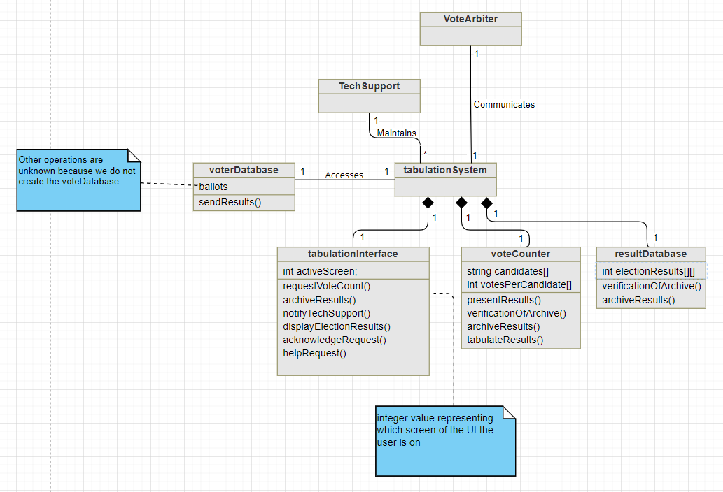
Class diagram

Slide 11
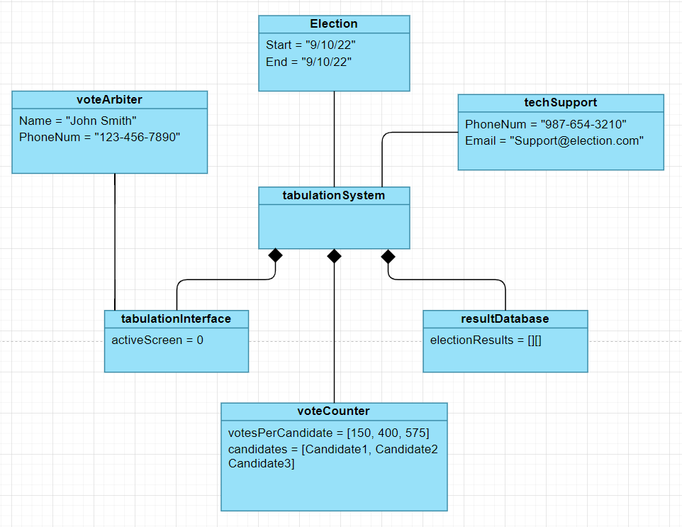
The Object Model

Slide 12
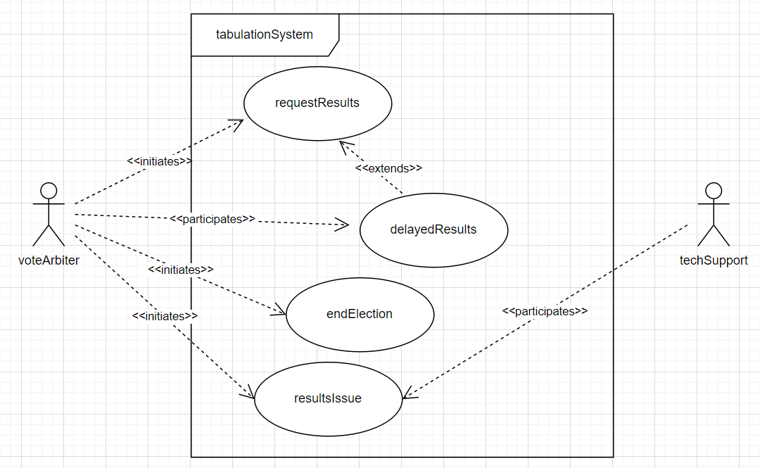
Use Case Model and UI

Slide 13
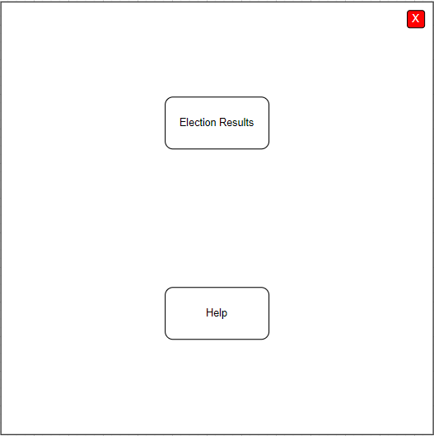
Use Case Model and UI

Slide 14
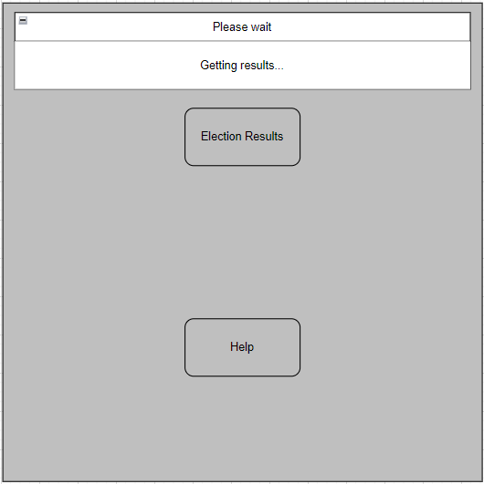
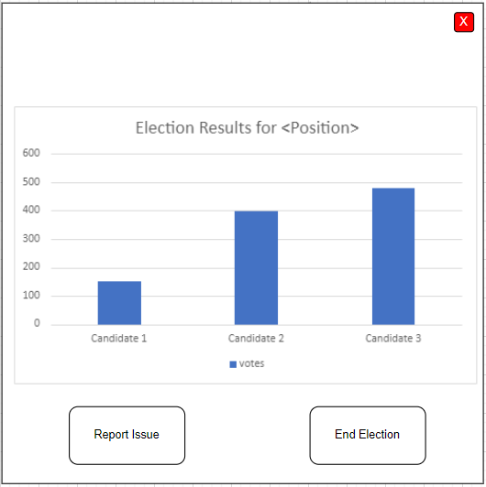
Use Case Model and UI

Slide 15
Use Case Model and UI

Slide 16
Use Case Model and UI

Slide 17
Use Case Model and UI

Slide 18
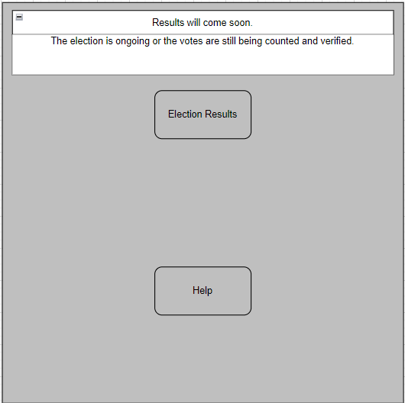
Use Case Model and UI

Slide 19
Use Case Model and UI

Slide 20
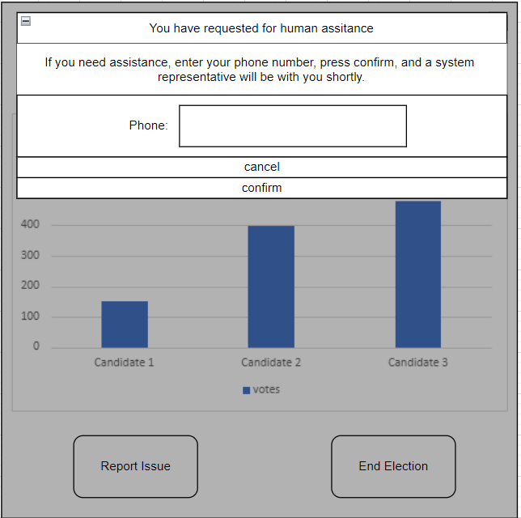
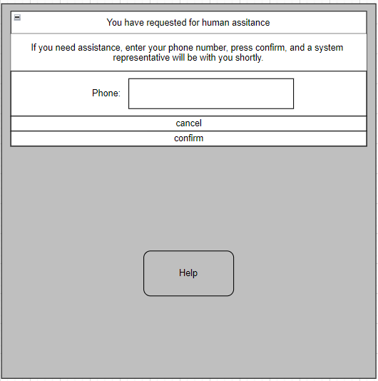
Use Case Model and UI

Slide 21
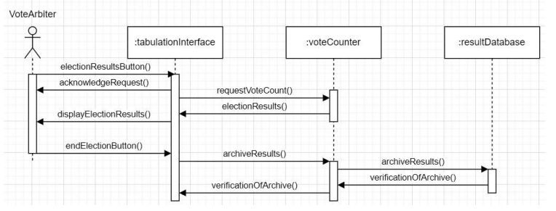
Sequence Diagram

Slide 22
Tracked Changes
Critiques and Updates
Changes adopted: end user to student government representatives, winner to display vote count, added error logs(for auditing), added topic object.
Did not move forward with: Election Setup

Slide 23
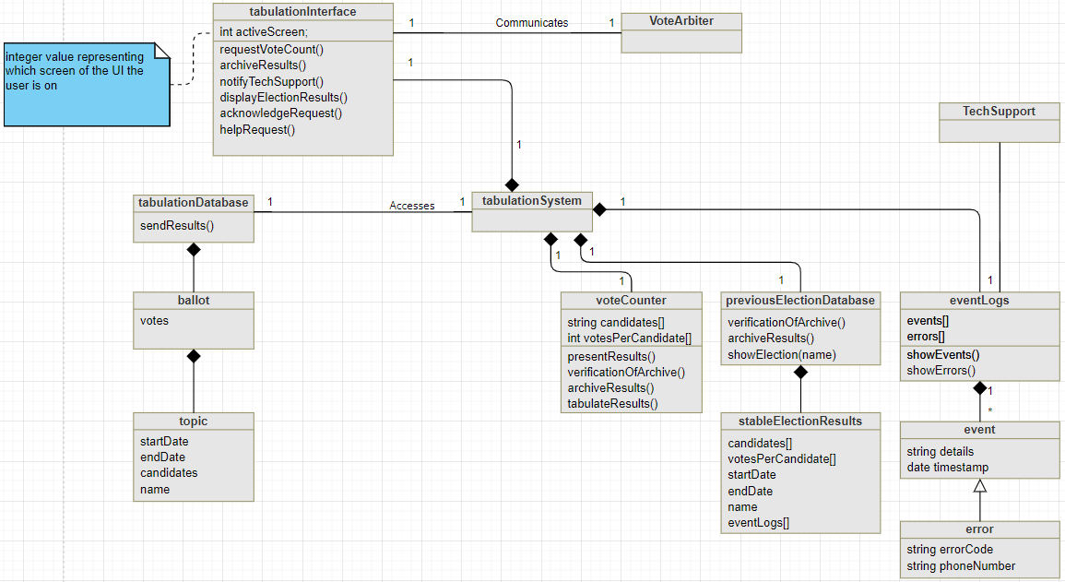
Diagram Changes - Class
Notes:
Miguel is talking about this

Slide 24
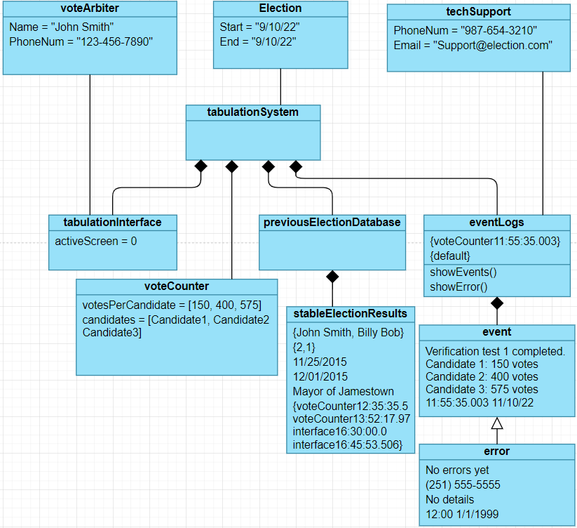
Diagram Changes - Object

Slide 25
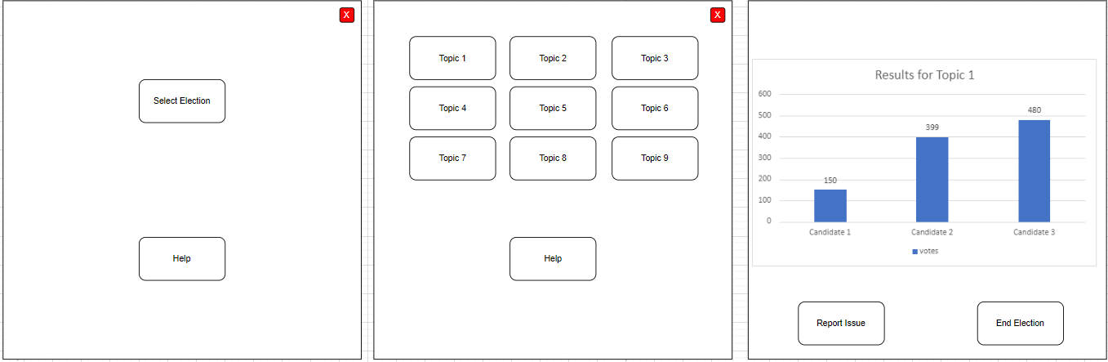
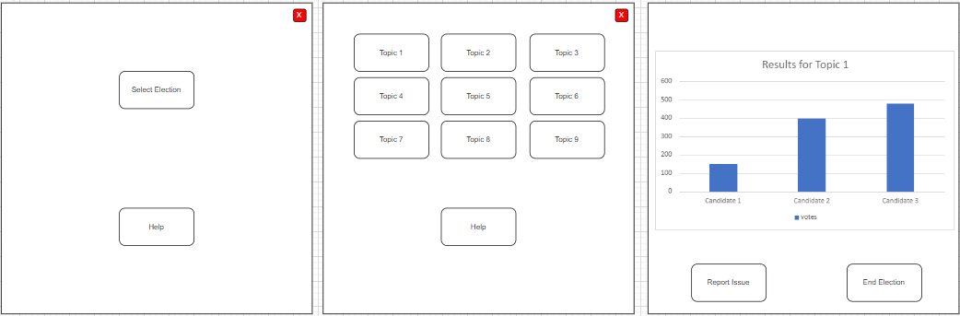
Diagram Changes - UI

Slide 26
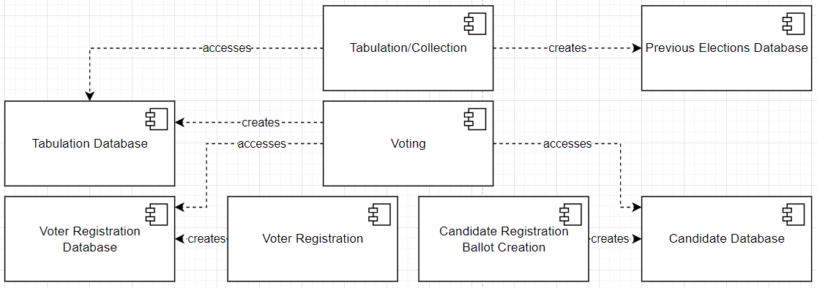
System Design Diagrams

Slide 27
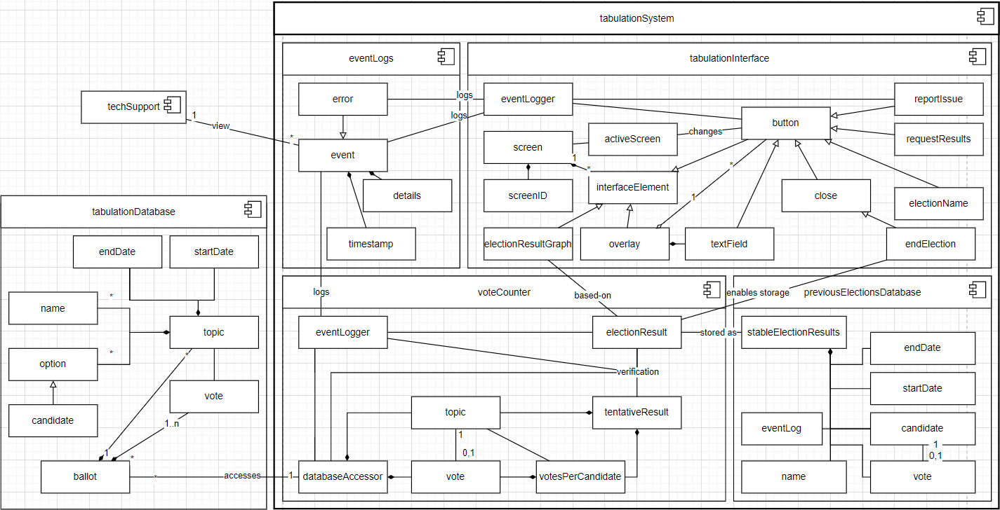

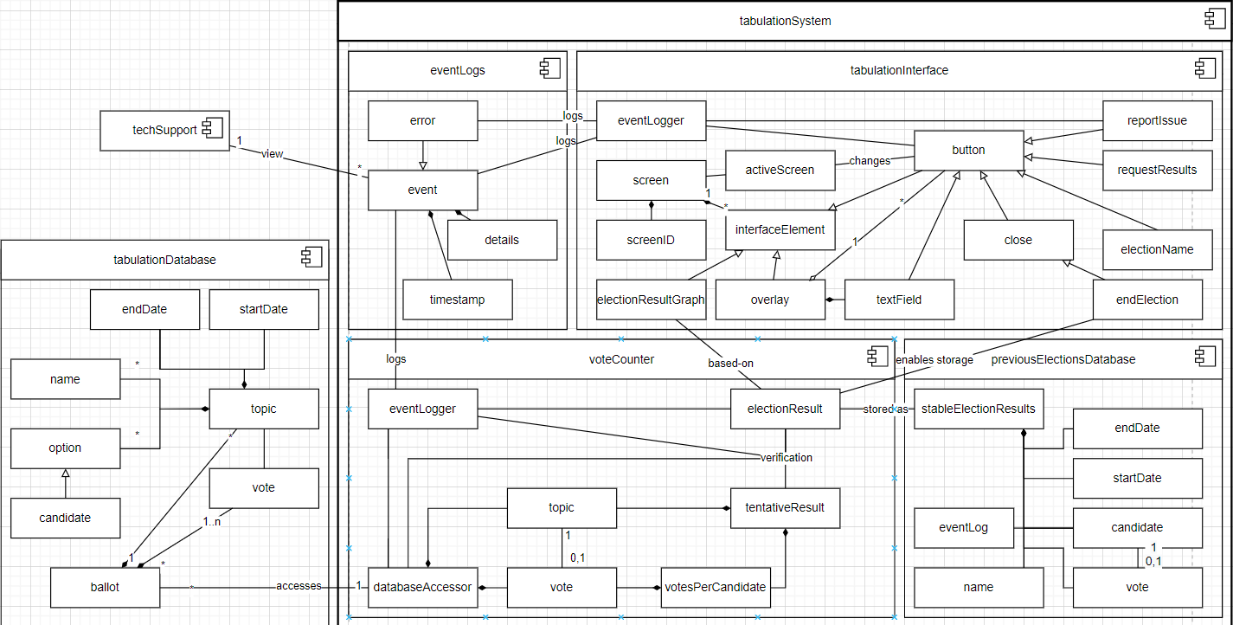

System Design Diagrams

Slide 28
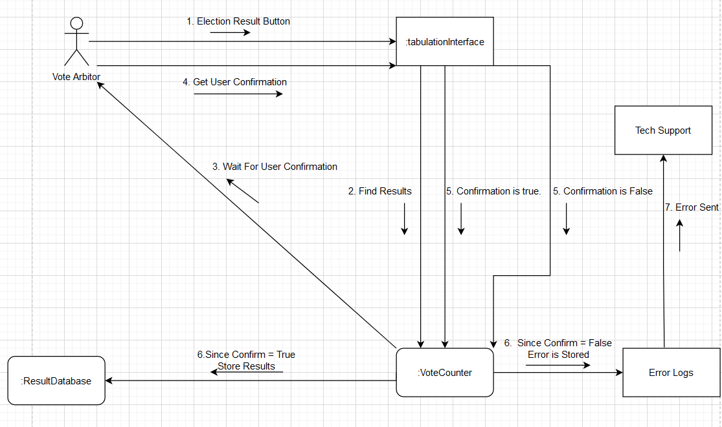
System Design Diagrams

Slide 29
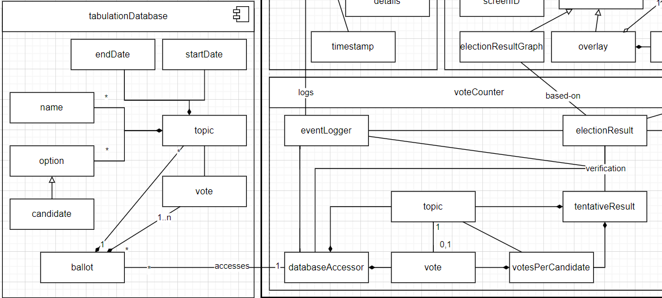
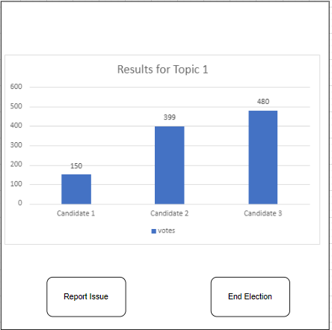
Trace requirements through Design Functionality
Support FPTP and RBV
Calculate the winner, standings and votes per candidate
The vote arbiter only has access to simple data
The vote arbiter cannot manipulate the data using the system

Slide 30
FURPS- Usability
The user uses simple buttons to get election results.
Data is organized to be simple to read.
The design of the UI is simplistic as possible as not not need training to navigate

Slide 31
FURPS- Reliability
The system does not overwrite existing data
The system does not store sensitive data in active memory
The system does not create data through a time intensive method

Slide 32
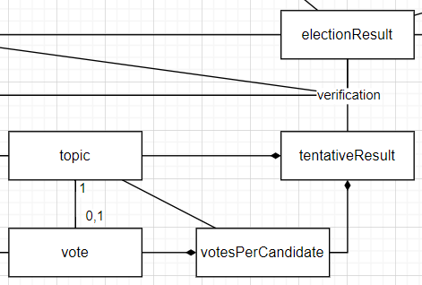
FURPS- Performance
Throughput of 20,000/hour worst case

Slide 33
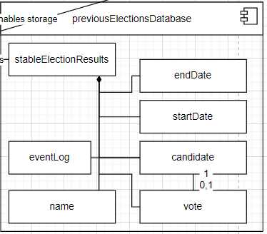
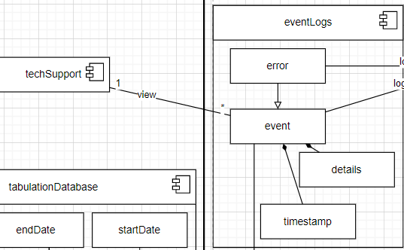
FURPS- Supportability
Support Mobile and Desktop voting teams’ inputs
Event Logging

Slide 34
Questions?
Ask away

Slide 35
Present Requirement and Analysis Diagrams Miguel,Abram,Alex
Requirement Diagrams
use case diagram
class diagram (?)
Analysis Diagrams
sequence diagrams (?)
object diagrams (?)

Slide 36
Michael
Furps (functionality, usability, reliability, performance, supportability).
PLAN: Make five slides for FURPS, spend approximately 45 seconds on each of those, then spend the remaining 1 minute 15 seconds on tracing design through requirements.

Slide 37
Things we need - ADD THE EMAILS SHOWING THE REQUIREMENTS
○ what have we done, what did we do to improve that
○ create diagrams and review those diagrams
○ show how requirements affected the design
1. present Requirements anal alalalalysis diagrams
2. present system design diags - how are the systems going to interact
3. trace requirements through design

Slide 38
Organize later
As the tabulation team, our job is to count the votes in a secure, accurate manner.
We met on September 9th, September 23rd, and October 14th (today) to work on the project.
We worked on our project during lab time after class several times.

Slide 39
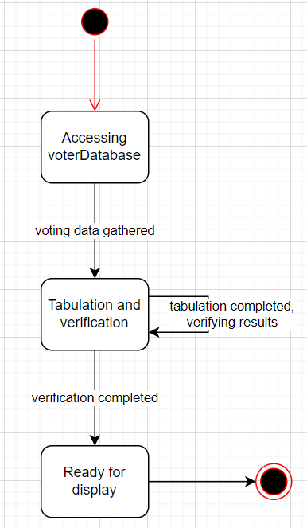
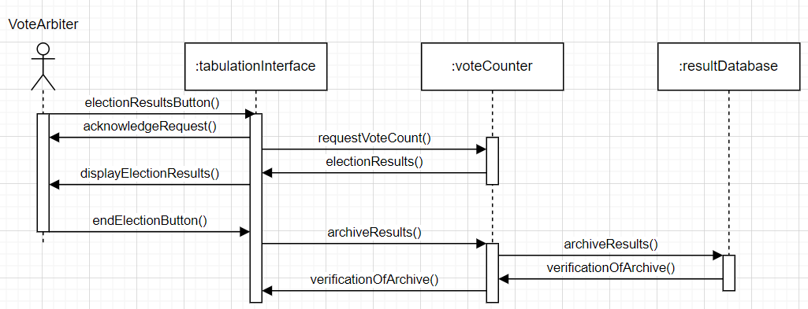
All the diagrams

Slide 40
Our Job
As the tabulation team, we are responsible for counting the votes securely and accurately.
(Talk about the use case model and explain the different scenarios the end user can be in)

Slide 41
1. Present Requirement and Analysis Diagrams
2. Present System Design Diagrams
3. Trace requirements through Design
1. The first item reflects the work that your group did to complete the RAD assignment. At a minimum, the representation should incorporate the requirements and analysis documents that you submitted to satisfy the requirements of the graded RAD lab, including any update/improvement that your team may desire to make to the baselined requirements and analysis documents. As discussed in class, you may also want to address the process that your team employed in producing the requirements and analysis documents.
2. The second item reflects the work that your team will accomplish in the next step of the development process (i.e. System Design), possibly including supporting documents such as your team lab journal entries.
3. The final item requires that your team show how the requirements evolved in to the system design, i.e. trace the requirements through analysis and into your design.
> Just to clarify, what exactly are the “System Design Diagrams” that we need to present?
Good question! The answer is in the textbook and our slides. Chapter 6 and the associated class presentation describe the system design process, e.g. describing how to transition from the “problem” diagrams from the analysis phase to the “solution” diagrams that are developed in system design, e.g. it describes partitioning as being a key element of system design.

